Slide 1
Minor project
9 dec 2024…..

Slide 2
Project name pg management system
.

Slide 3
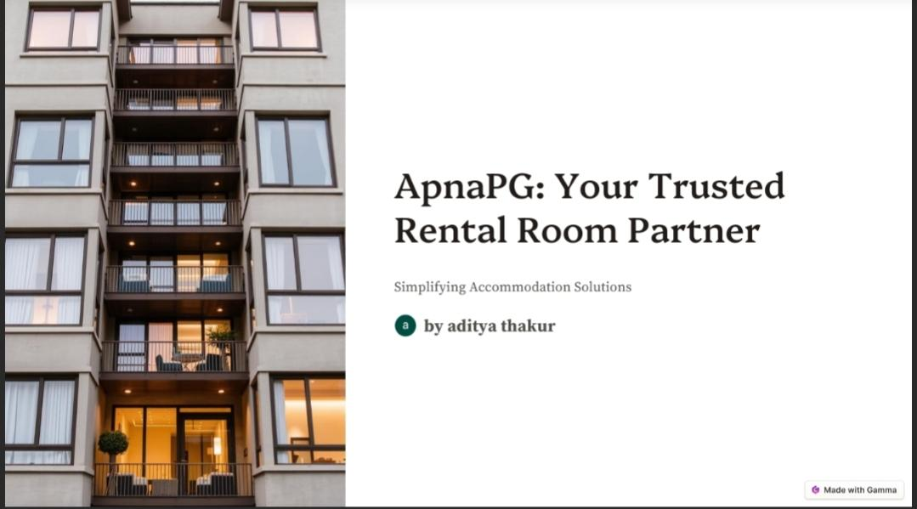

Slide 4
By
Shridhar aditya SBU220799
Aditya thakur sbu220803
Mohammad sohail Sbu220804

Slide 5
Introduction
The Online PG (Paying Guest) Management System is a dynamic and interactive platform designed to facilitate users in finding, listing, and managing PG accommodations. This system aims to provide an easy-to-use interface for both PG owners and potential tenants to interact efficiently, offering features such as property listings, search filters, and responsive design. Built using modern web technologies such as HTML, CSS, JavaScript, and frameworks for enhanced functionality, this platform ensures a seamless user experience across devices.

Slide 6
Technologies used
HTML (HyperText Markup Language):Provides the basic structure of the website and the platform's content
CSS (Cascading Style Sheets):Ensures the design is visually appealing, making use of styles for layout, colors, fonts, and overall aesthetics

Slide 7
.
JavaScript:Implements interactive features like dynamic search, filters, and PG listing management
Frameworks (Optional):Bootstrap for responsive design.
Reacts/Angular for improved interactivity and dynamic content loading (if applicable).

Slide 8
PG Listing.
PG owners can list their accommodations, providing details such as room type, facilities, rent, location, and photos.Users can browse through available PGs with ease.Search and Filter:Users can search for PGs based on criteria like rent, location, facilities, and room type.Filters enable a more refined search, making it easier to find the most relevant results.

Slide 9
..
Search and Filter.
Users can search for PGs based on criteria like rent, location, facilities, and room type
Filters enable a more refined search, making it easier to find the most relevant results.

Slide 10
.
Responsive Design
The platform is fully responsive, ensuring that it is accessible and functional on all devices—desktops, tablets, and smartphones.The layout automatically adjusts to different screen sizes, providing an optimal browsing experience
User-Friendly Interface
Simple and intuitive navigation ensures that even first-time users can easily use the platform without a steep learning curve.

Slide 11
.
PG Owner Dashboard:
PG owners can manage their listings—add, update, or delete details about their properties
User Accounts and Reviews
Tenants can create accounts, rate and review PGs, adding transparency and reliability to the platform.

Slide 12
Conclusion
The Online PG Management System is an innovative solution for managing PG accommodations, offering an easy-to-use platform for both PG owners and tenants. By integrating powerful features like advanced search filters, detailed PG listings, and a responsive design, it provides a modern solution to an often tedious and time-consuming process of finding or managing PG properties. The use of HTML, CSS, JavaScript, and frameworks ensures a smooth, interactive, and visually appealing user experience.

Slide 13
Future scope
Mobile Application:
Developing a mobile app to complement the web platform, making it more accessible and convenient for users
Real-time Chat Feature:
Introducing a live chat option between PG owners and tenants for instant communication.

Slide 14
.
Payment Integration:
Adding online payment gateways for secure rent payments directly through the platform.
Admin Panel:
Building an admin panel to monitor and manage user activity, listings, and content moderation
.Advanced Filtering Options:
Adding more detailed filters, such as proximity to landmarks, local amenities, or transportation hubs.

Slide 15
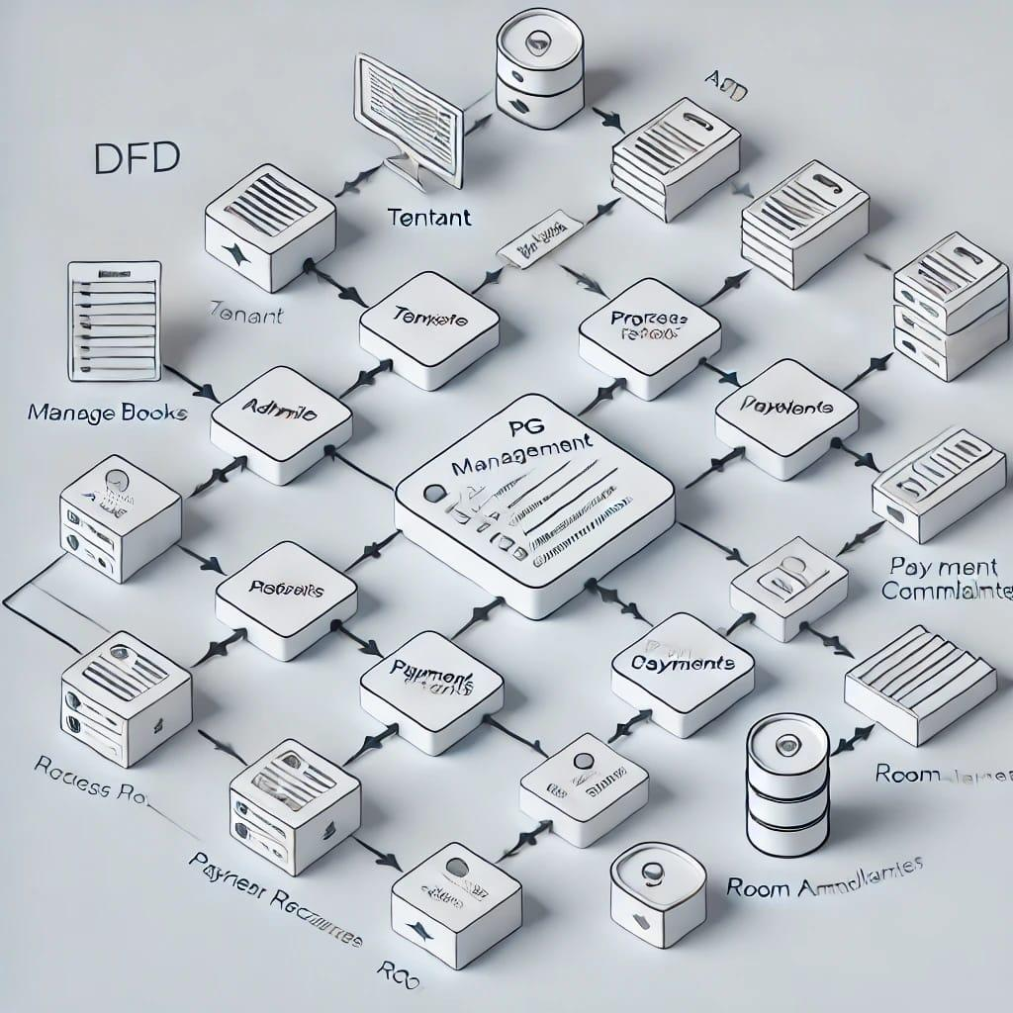

Slide 16
Thank you

